Slide 1
SURGICAL PROCEDURES IN GLAUCOMA
Dr. Vivekanand U

Slide 2
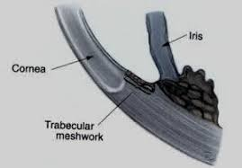
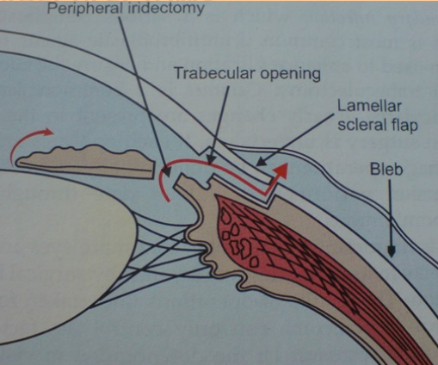
APPLIED ANATOMY OF ANGLE AND PRINCIPLE OF GLAUCOMA SURGERY

Slide 3
CLASSIFICATION
Peripheral iridectomy
Goniotomy and trabeculotomy
Filtering procedures (trabeculectomy)
EXTERNAL
Full thickness
Partial thickness
Non penetrating
B. INTERNAL ( canaloplasty, trabectome, i-Stent )

Slide 4
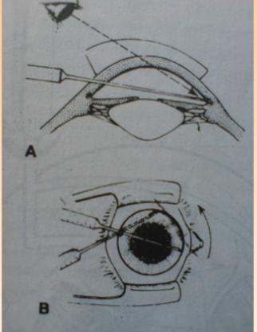
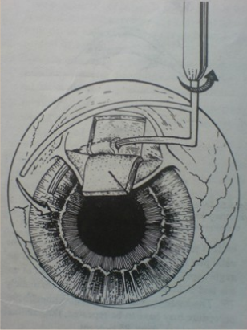
CONGENITAL GLAUCOMA
GONIOTOMY
TRABECULOTOMY

Slide 5
Full thickness- filtering procedure
Elliot’s sclerocorneal trephining
Punch sclerectomy
Scheie’s thermosclerostomy
Iridencleisis

Slide 6
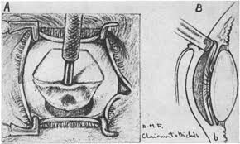
Elliot’s sclerocorneal trephining

Slide 7
PARTIAL THICKNESS
Indications for Trabeculectomy
1. Failed medical therapy and laser trabeculoplasty
2. Lack of suitability for trabeculoplasty
Poor patient co-operation
Inability to adequately visualize trabeculum
3. As primary therapy in advanced disease

Slide 8
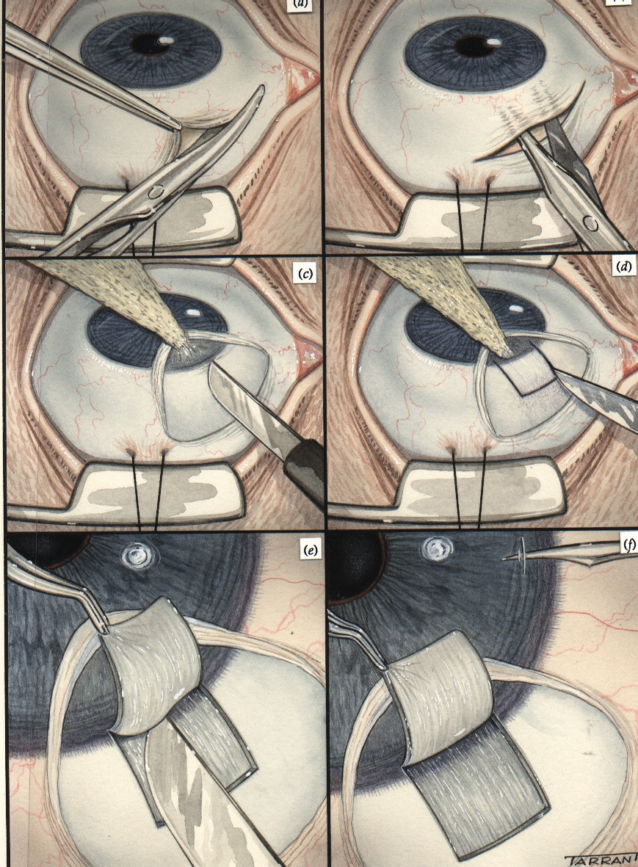
Technique (1)
a
b
a. Conjunctival incision
b. Conjunctival undermining
c
d
c. Clearing of limbus
d. Outline of superficial flap
e
f
e. Dissection of superficial flap
f. Paracentesis

Slide 9
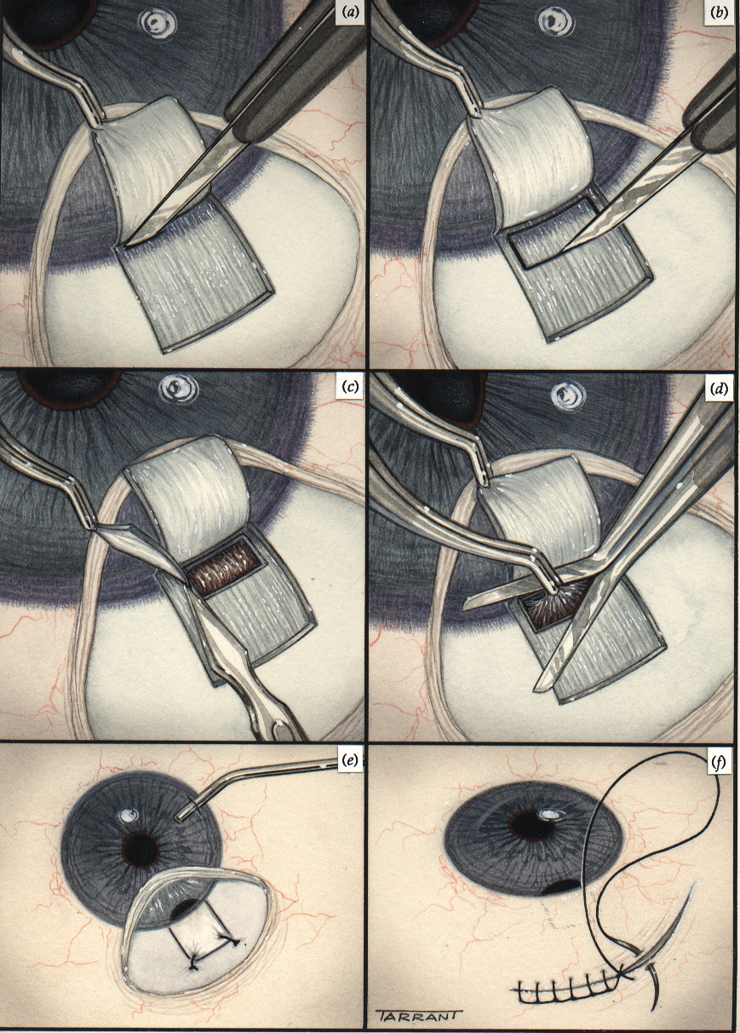
Technique (2)
a
b
a. Cutting of deep block -
anterior incision
b. Posterior incision
c
d
c. Excision of deep block
d. Peripheral iridectomy
e
f
e. Suturing of flap and
reconstitution of
anterior chamber
f. Suturing of conjunctiva

Slide 10
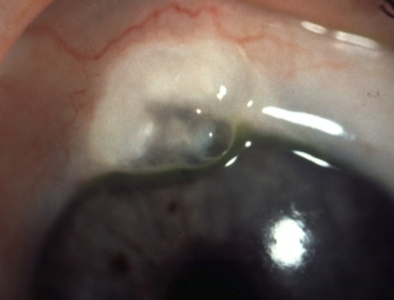
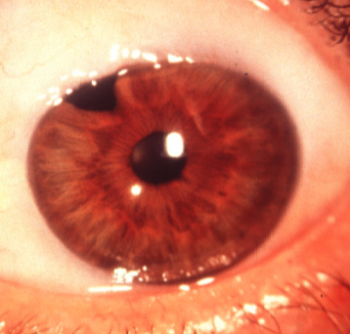
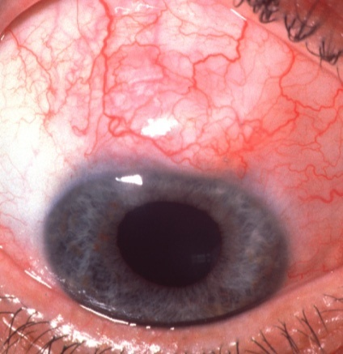
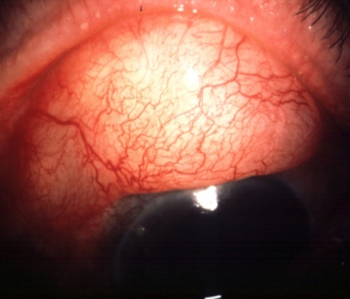
Filtration blebs
Type 1
Type 2
Flat, thin and diffuse
Thin and polycystic
Relatively avascular
Good filtration
Microcysts present
Good filtration
Type 3
Encapsulated
Flat
Localized, firm cyst
Engorged surface vessels
Engorged surface vessels
No microcysts
No filtration
No filtration

Slide 11
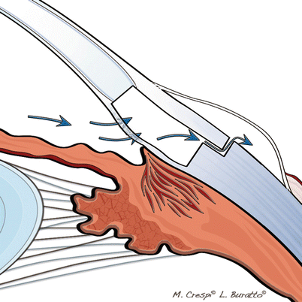
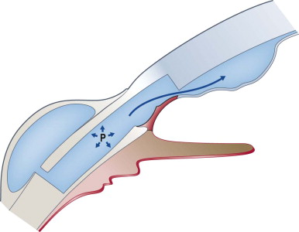
NON PENETRATING FILTERATION SURGERY
VISCO CANALOSTOMY
DEEP SCLERECTOMY

Slide 12
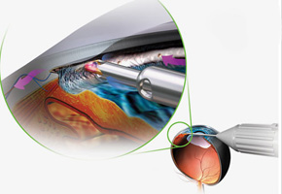
INTERNAL FILTERATION SURGERIES ( CANAL BASED PROCEDURE)
Canaloplasty.
Trabectome involves an ab interno microcautery
iStent, is a titanium micro device ( placed inside the Schlemm’s canal)

